Slide 1
EULAide: Ontology-Driven Summarization and Visualization of Legal Documents
Team:
Ahmad Hemid
Lars Möllenbrok
Isunge Mwangase
Md Saiful Islam Faisal
Mentor:
Najmeh Mousavi Nejad
Notes:
15 seconds

Slide 2

Outline
Motivation
❖ Objective
⬥ Tasks
 System Architecture
Visualization of policies
 Testing
Mock-up
 Future Work
 Demo
Notes:
30 seconds

Slide 3
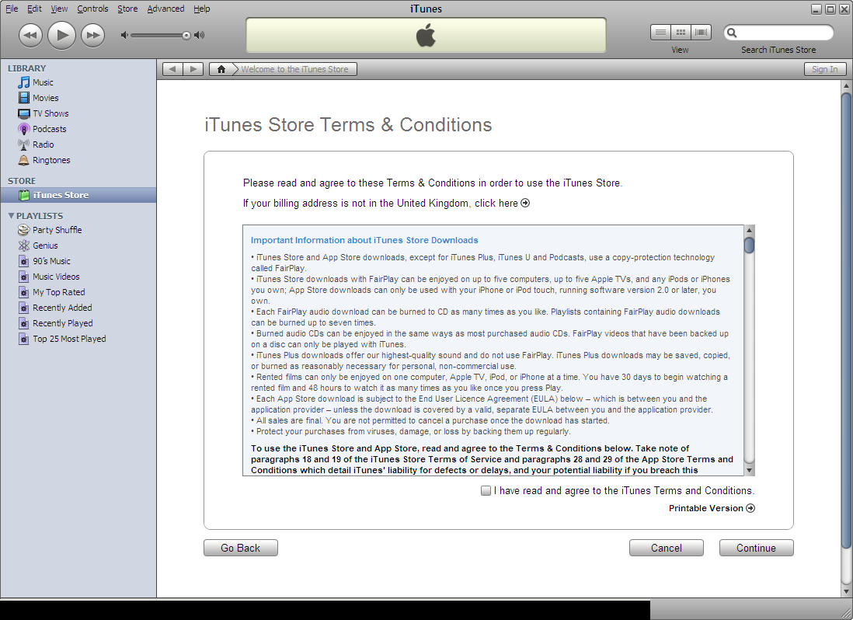
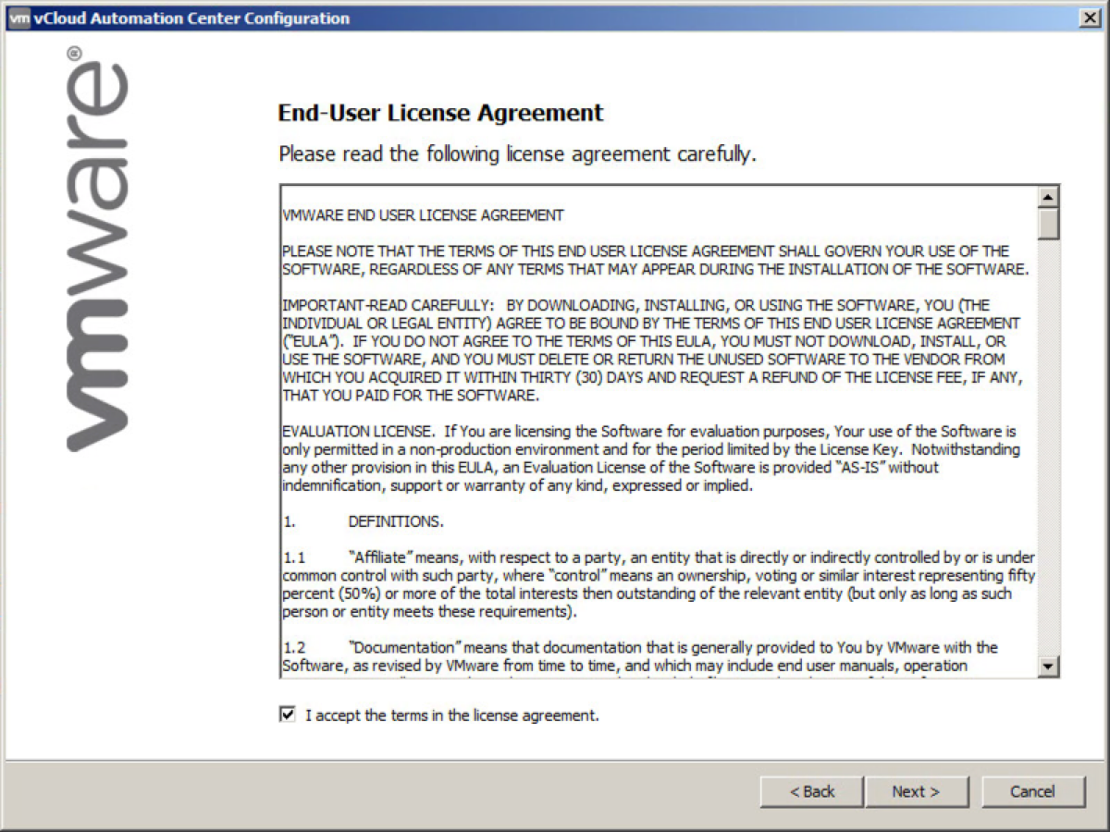
Motivation
EULA being ignored most of the time!
Consequences of ignoring!
What is the solution?
Notes:
60 seconds
Eula details []
People are ignoring them
Reason of being ignored! Too much to read!
Possible consequences include : Privacy compromise, security risk and legal action against user

Slide 4
Objective
Use ontology-based information extraction to faciliate a better understanding of EULAs.
Notes:
30 seconds
- Our system will help the user the understand the EULA with less reading

Slide 5
Tasks
Implementation of GATE in java
Restful Web Service
Visualization of policies
Implementation of Web App
Mobile Application Mockup
Notes:
60 seconds
GATE for ontology-based information extraction

Slide 6
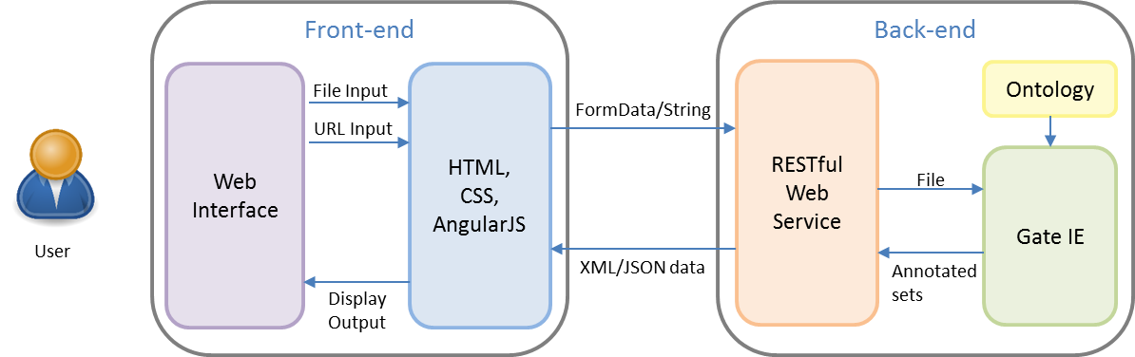


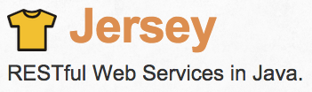



System Architecture
Notes:
[90 seconds]
Backend
We already have ontology from our mentor, also base part of the information extraction part from GATE
We part of Gate to support working on Rest
Adding a RESTful web service

Slide 7

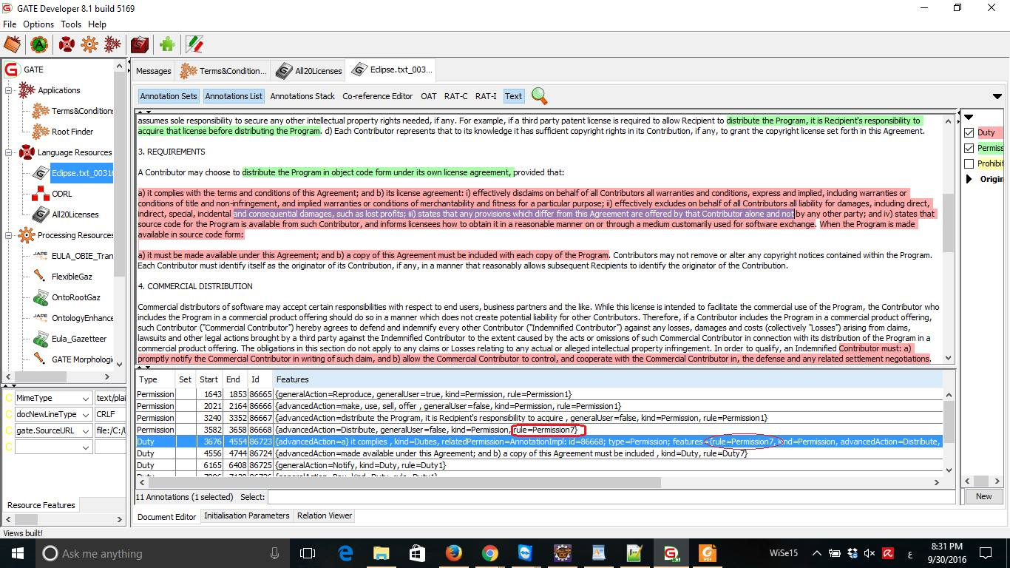
GATE Developer
Notes:
30 seconds

Slide 8
Restful Web Service
POST /eula/fileUploadXML
POST /eula/urlUploadXML
Param : multipart/form-data
Param : text/plain (URL)
Response : application/xml
Response : application/xml
POST /eula/fileUploadJSON
POST /eula/urlUploadJSON
Param : multipart/form-data
Param : text/plain (URL)
Response : application/json
Response : application/json
Notes:
30 seconds

Slide 9
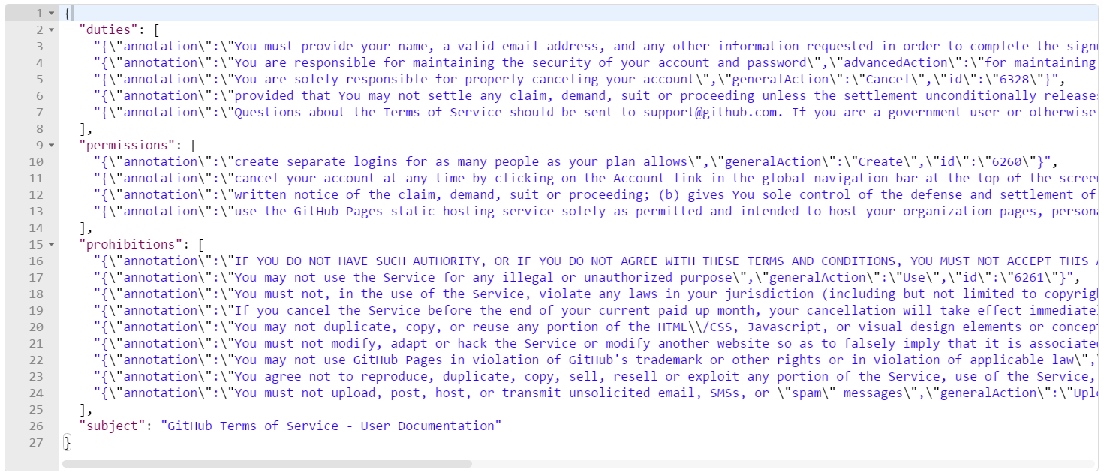
Visualization of policies
Output of JSON Format

Slide 10






Visualization of policies
Mapping text instances with icons
{“duties” : [
"{\"annotation\": “….”,
"{\"annotation\": “….”,
"{\"annotation\": “….”
.
.
….],
“permissions” : [],
“prohibitions” : []}
GeneralAction annotations

Slide 11
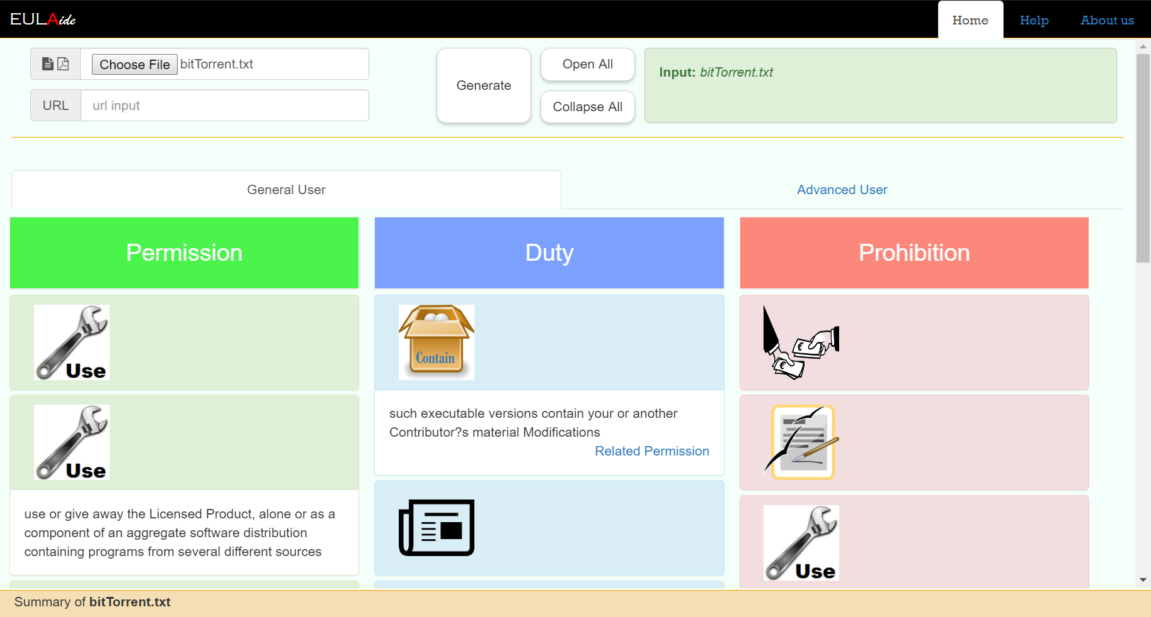
Visualization of policies

Slide 12
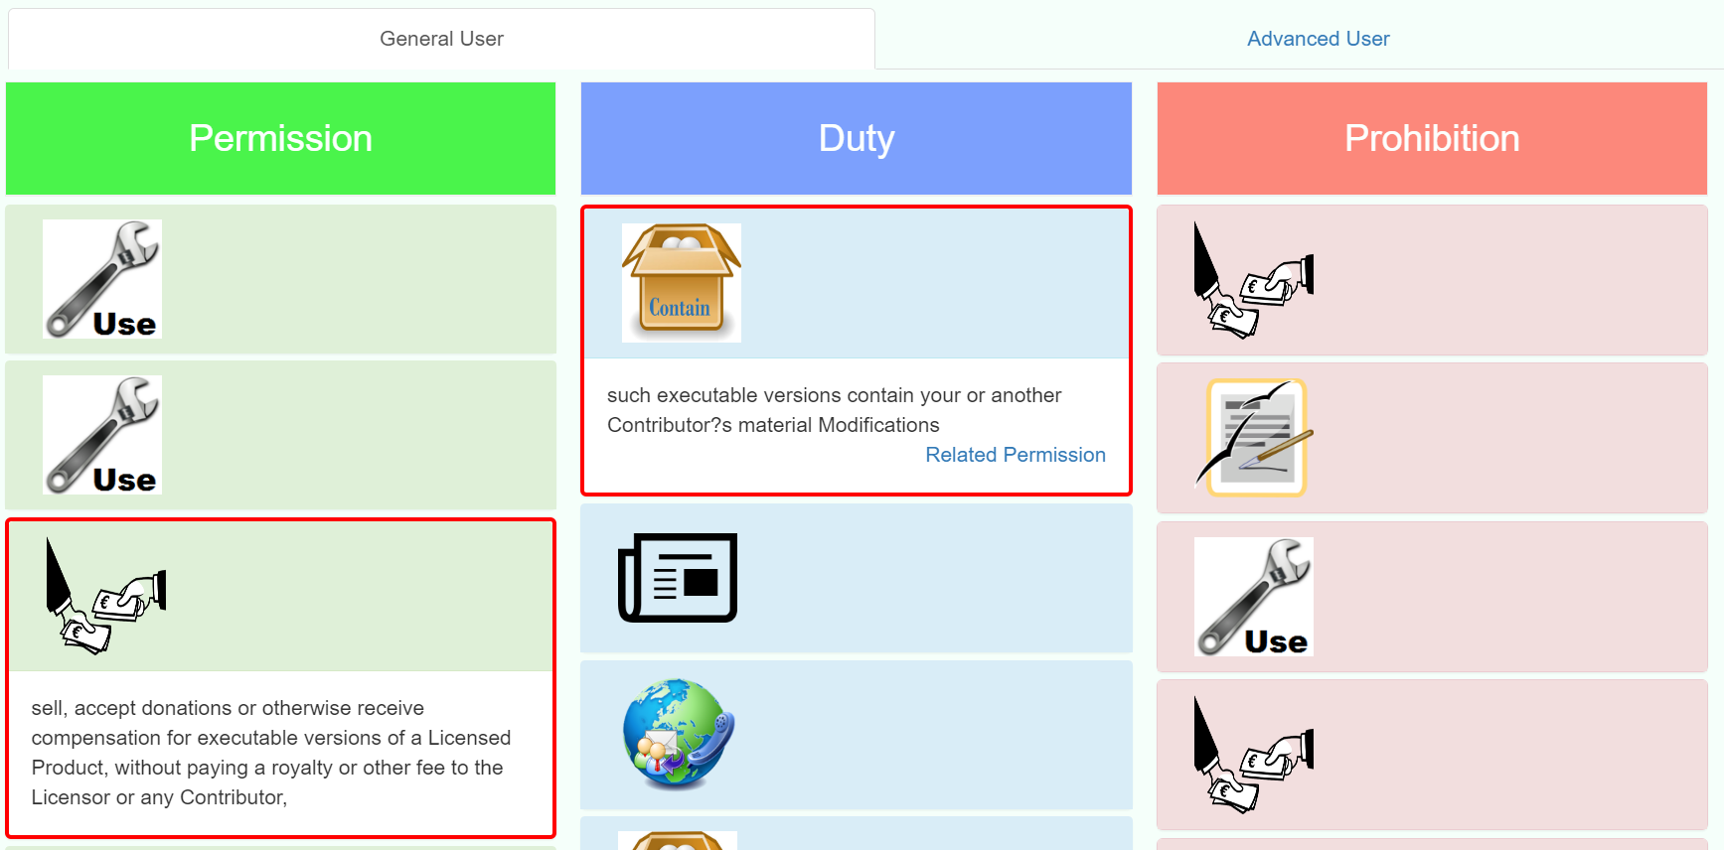
Visualization of policies
Duties with related Permissions

Slide 13

Testing
Unit testing
File format validation
Correct format (.txt, .pdf)
Wrong format (.jpg or any other types)
URL validation
Empty URL
Non-empty URL
Notes:
60 seconds
-

Slide 14

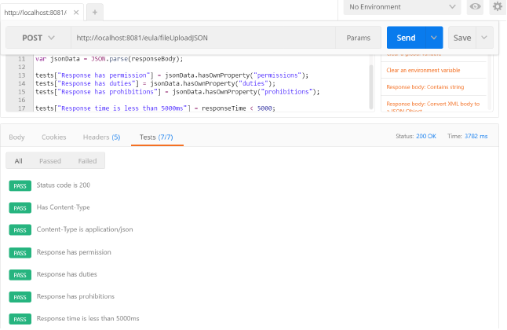
Testing
Integration testing
Status Code
Response Content-type
application/json
application/xml
Content of the response
‘permissions’, ‘duties’, ‘prohibition’
Postman
Notes:
60 seconds
Postman
Postman, which comes with powerful HTTP client support. It is light and faster.

Slide 15
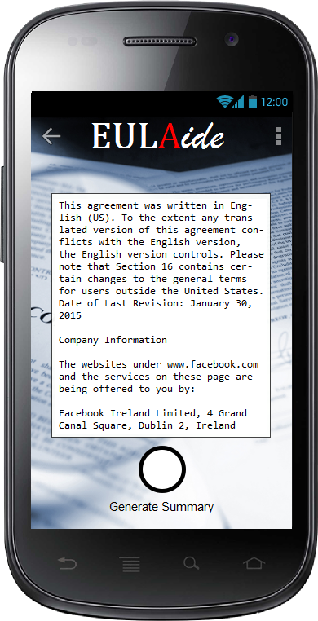
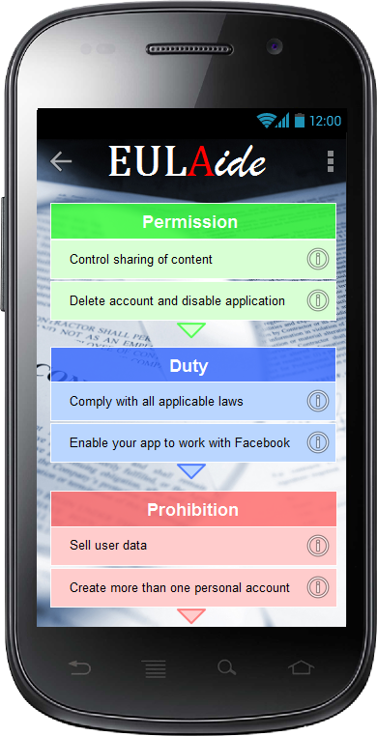


Mock-up
Development Tools
Notes:
120 seconds

Slide 16
Future Work
Developement of an app for the major mobile operating systems
User interaction to give feedback and report problems
Notes:
30 seconds

Slide 17
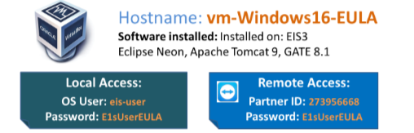
Demo
Notes:
180 seconds

